Slide 1
Query Store Unleashed: Boosting SQL Server 2022 & Azure Performance
Deepthi Goguri
She/Her
Database Administrator

Slide 2

Deepthi Goguri
Data Platform MVP
Masters in Computer Technology
Co-Organizer for Data and AI South Florida User Group, DEI User Group, Data TGIF
Volunteer for Women in Technology User Group
Loves Plants, Arts and Crafts
Twitter: @dbanuggets
Website: https://dbanuggets.com/
Linkedin: https://www.linkedin.com/in/deepthigoguri/

Slide 3
Agenda
Query Store Basics
Query Store Architecture
Benefits
Advanced Features in SQL Server 2022
Key Takeaways

Slide 4
Times before Query Store…

Slide 5
On-Call Emergency Situation
Application down
Query timeout
No changes were made

Slide 6
Investigation
Execution plan from the plan cache
DMV’s
Memory pressure
Configuration settings
Indexes, Statistics updates – can generate new plan

Slide 7
How we solved this issue?
Checking the execution plan, tuning Query
Adding any missing Indexes, updating stats and so on…
Checking Monitoring tools- View the last Good plan
Use Plan Guide – Tricky and hard to implement

Slide 8
Problem- Not easy to identify and use the last Good plan!

Slide 9
Solution: Query Store

Slide 10
Query Store
Introduced in SQL Server 2016
Captures history of query plans
Option to choose optimal plan
Collects resource usage info and execution stats info

Slide 11
Configuration
Database level option
Enabled default on Azure SQL DB
Azure Synapse Analytics Database (dedicated SQL pool only)
Cannot enable on master or tempdb
Permissions – View Database State and Alter DB

Slide 12
How Query Store Works?

Slide 13
Query
Are you running for the first time?
YES
NO
Compilation and Optimization
Plan in Cache?
NO
YES
Is this plan the same forced plan?
But wait, check for recompilation!
Alright, then take it from the plan cache!
CHECK
Oops, NO!
YES
1. Async
Query Text
Query Plan
Async
Plan Store
Query Store
Schema
Apply the forced plan
2. Run
In-Memory
Async
Query Executes
Async
Run time Stats
Runtime stats Store

Slide 14
What data is collected?
SQL Server 2017+ includes wait stats information
CPU, IO, Memory
Duration, Logical Reads and Writes, Physical Reads, CLR Time, DOP, Row Count, Log Memory Used, Temp DB Memory Used, and Wait Time
History of the plans
Resource-consuming queries

Slide 15
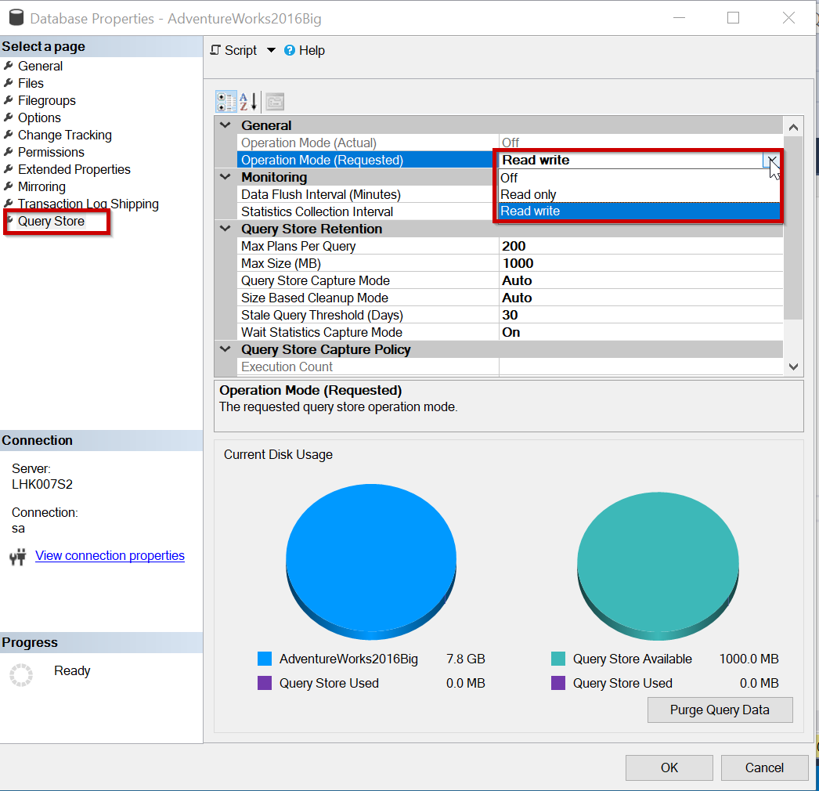
Query Store Operation Mode

Slide 16
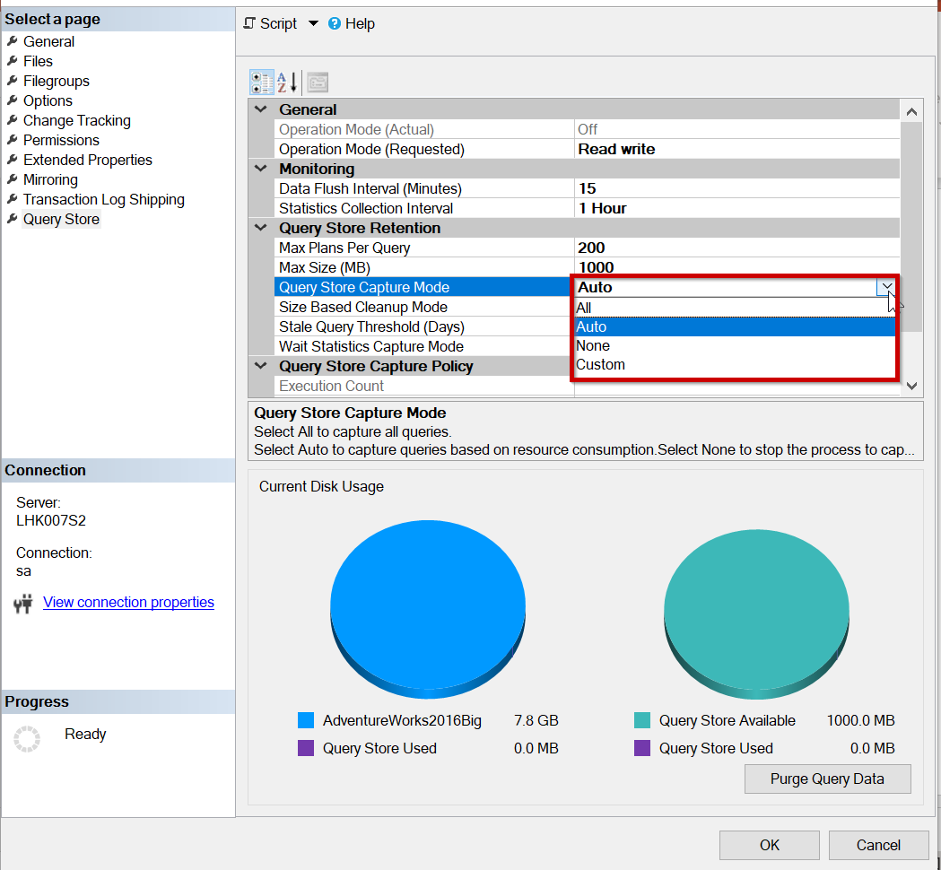
Query Store Capture Mode

Slide 17
Query Store benefits
Identify regressions due to plan changes
Quickly fixes non-optimal plan usage
Performance tuning
No changes needed to user applications or underlying code
Useful during the database upgrades

Slide 18
Plan Forcing

Slide 19
Plan Forcing
Just like the USE PLAN query hint
Optimizer uses the forced plan
If it fails, optimize in the regular way
Force using sp_query_store_force_plan
Unforce using sp_query_store_unforce_plan

Slide 20
Automatic Plan Correction

Slide 21

Automatic plan correction
SQL Server 2017 and above
Continuous monitoring for plan regression
Adjust accordingly by forcing/unforcing

Slide 22
Automatic plan correction
Enable using T-SQL or using the Azure portal
T-SQL
ALTER DATABASE Databasename
SET AUTOMATIC_TUNING (FORCE_LAST_GOOD_PLAN = ON );
sys.dm_db_tuning_recommendations

Slide 23
DEMO

Slide 24
Recap of what we learnt so far..
Query Store Basics and Architecture
Benefits with example of capturing baselines
Forcing/unforcing
Automatic plan correction

Slide 25
Query Store Advancements in SQL Server 2022

Slide 26
QS Advancements in SQL Server 2022
Enabled by Default
Query Store data capture in secondary replica (preview)
Query Store hints
IQP features using Query Store
Memory grant feedback
Degree of parallelism (DOP) feedback
Cardinality estimation feedback
Optimized plan forcing

Slide 27
Highlights for IQP features
No code changes – Works with latest Compatibility level
They work together (can have multiple features supporting query)
Large positive impact in performance

Slide 28
Query Store for Secondary Replicas

Slide 29
Query Store for Secondary Replicas
Sends data to Primary QS db
Enable Trace Flag 12606
Primary
Read/write
Read only secondary
Can Query data visible by Role type or by secondary name
Sends data to Primary QS db
Read only secondary
***Query Store for secondary replicas is available for preview. It isn't available for use in production environments.

Slide 30
Enable using T-SQL
1. First QS needs to be enabled on Primary replica database
ALTER DATABASE [Database_Name] SET QUERY_STORE = ON;
GO
ALTER DATABASE [Database_Name]
SET QUERY_STORE ( OPERATION_MODE = READ_WRITE );

Slide 31
Enable using T-SQL
2. Connect to Primary Replica and run on each desired database
ALTER DATABASE [Database_Name]
FOR SECONDARY SET QUERY_STORE = ON (OPERATION_MODE = READ_WRITE );
GO

Slide 32
Enable using T-SQL
3. To disable, connect to primary and run on each desired database
ALTER DATABASE [Database_Name]
FOR SECONDARY SET QUERY_STORE = OFF;
GO

Slide 33
How to Force/Unforce plans on Secondary
Optional plan scoped argument can be added
EXEC sp_query_store_force_plan 26012, 3, 2;
EXEC sp_query_store_unforce_plan 26012, 3, 2;
Plan Forcing Scope parameter
0 = Force on read-write replica (default)
1 = Force/unforce on all read-only replicas
2 = Force/unforce on all replicas
Resource: https://www.youtube.com/watch?v=BbaC6-2qsjI

Slide 34
Query Store Hints

Slide 35
Query Store Hints
Used for optimizing specific queries under specific conditions
SQL Server 2022, Azure SQL databases, elastic pools, managed instances, and hyperscale databases
Simple to fix without modifying underlining code
Query hints like MAXDOP, recompile, max/min memory grant size, compatibility level, etc.

Slide 36
Two Step Process
Get the query_id from catalog views
Stored procedure sp_query_store_set_hints
Example:
EXEC sp_query_store_set_hints @query_id=5, @value = N'OPTION(RECOMPILE)';

Slide 37
Things to Remember
Any query hints in your code will override
QS hints are persisted
Table hints are not supported
Override hard-coded statement level hints and plan guide hints

Slide 38
Recap of what we learnt so far..
Query Store advancements in SQL Server 2022
Query Store for Secondary Replicas
Query Hints
Things to remember

Slide 39
Key Takeaways

Slide 40
Takeaways (1/4)
Cannot be disabled in Azure SQL Database single database and Elastic Pool
TF 7745 to avoid writing QS data to disk before SQL Server shutdown
TF 7752 enables asynchronous load of Query Store (default in SQL Server 2019)
Source: https://docs.microsoft.com/sql/relational-databases/performance/best-practice-with-the-query-store

Slide 41
Takeaways (2/4)
Natively compiled queries runtime stats
Enable sys.sp_xtp_control_query_exec_stats (not persisted, configure on every sql server restart)
If many unique ad-hoc queries, use Optimize for Ad hoc Workloads option to save cache memory
Source: https://docs.microsoft.com/sql/relational-databases/performance/monitoring-performance-by-using-the-query-store
https://docs.microsoft.com/sql/relational-databases/performance/best-practice-with-the-query-store

Slide 42
Takeaways (2/4)
Max plans per query is set as 200 execution plans per query by default
If MAX_STORAGE_SIZE_MB is reached, Query Store goes into read-only mode
Size Based Cleanup Mode to avoid changing to read only mode once max size is reached (90 percent of max_storage_size_mb)
Source: https://docs.microsoft.com/sql/relational-databases/system-catalog-views/sys-database-query-store-options-transact-sql
https://docs.microsoft.com/sql/relational-databases/performance/best-practice-with-the-query-store
https://docs.microsoft.com/sql/relational-databases/system-catalog-views/sys-database-query-store-options-transact-sql

Slide 43
Takeaways (3/4)
Auto mode (avoids ad-hoc queries with small resource consumption)
QS QUERY_CAPTURE_MODE to AUTO is recommended (Default in Azure SQL Database,SQL Server 2019)
Source: https://docs.microsoft.com/sql/relational-databases/performance/best-practice-with-the-query-store

Slide 44
Recap
Query Store Basics
Query Store Architecture
Benefits
Advanced Features in SQL Server 2022
Key Takeaways

Slide 45
References
Monitor performance by using the Query Store
Intelligent query processing in SQL databases
Best practices for monitoring workloads with Query Store
Azure SQL & SQL Server 2022: Intelligent Database Futures

Slide 46
Thank you!

